Slide 1
How to load FPGA Romcode
Modulator: Jay Gao

Slide 2
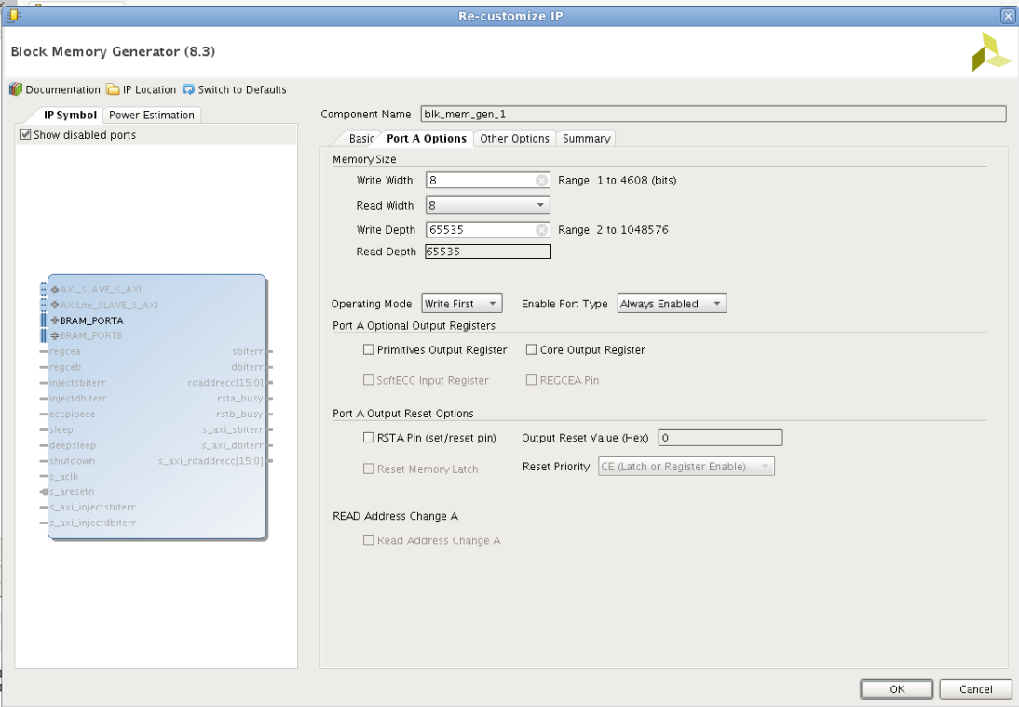

Slide 3
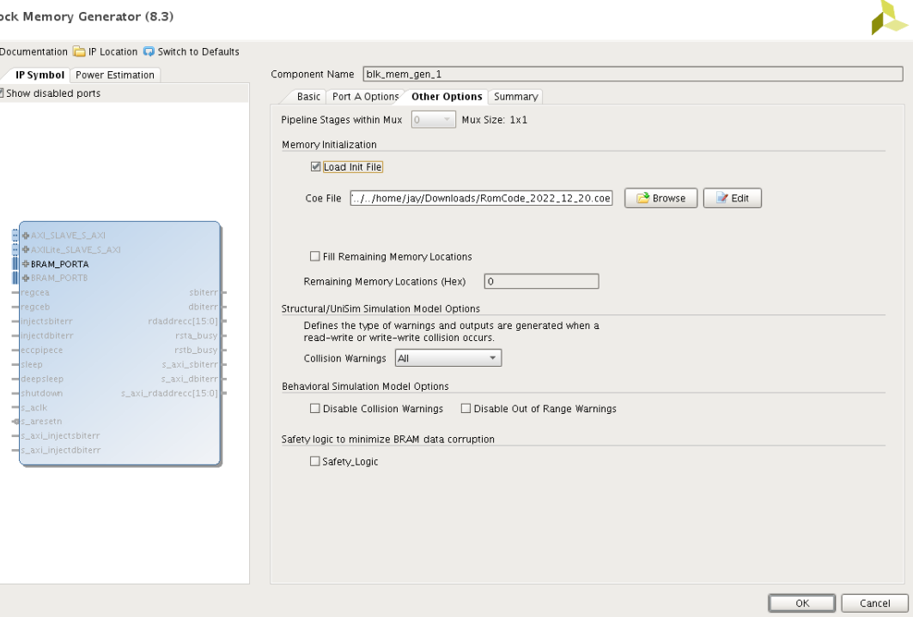

Slide 4
